Slide 1
CityU CSHK PASS SYMPOSIUM
Global Connectivity, Opportunities and Challenges: Hong Kong and ETCZs along Belt & Road
Opportunities For The Accountancy Industry
Speaker: Johnson Kong – Immediate Past President
Date: 7 January 2021
Notes:
Speaker notes:

Slide 2
Contents
1. Hong Kong Institute of Certified Public Accountants
2. Hong Kong Advantages
3. Opportunities for Accountancy Industry
4. Challenges & Risks

Slide 3
Hong Kong Institute of Certified Public Accountants
Established on 1 January 1973 under the Professional Accountants Ordinance
Only body authorized by law to register and grant practising certificates to CPAs in Hong Kong
Salient Roles:
  Qualification and licensing of accountants
  Standard setting
  Regulate the conduct of members
  Member support and development
  Total number of member: 46,433
  Total number of students: 18,152
  Total number of CPA practices: 1,926
  Member of IFAC
  (Figures as at 30 November 2020)

Slide 4
Hong Kong Advantages
Proximity to Mainland China
Internationality
  Connectivity to Asia and Beyond
  Quality and Diversity of Services
  Synergy
  Efficiency and Flexibility
Notes:
Speaker notes:

Slide 5
Opportunities for Accountancy Industry
Audit and Assurance
Business Valuation
  Consultancy
  Corporate Intelligence
  Corporate Services
  Financial Advisory
  Financial Due Diligence
  Fund Raising
  Human Capital Advisory
  Market Entry Strategies Analysis
  Merger & Acquisition Consulting
  Risk Management
  Tax Advisory
Notes:
Speaker notes:

Slide 6
Challenges & Risks
Mindset
Building a Platform
Small & Medium CPA Practices – Limitations
  Political, Economic and Cultural Considerations
  ETCZs
Notes:
Speaker notes:

Slide 7
Thank You

Slide 8
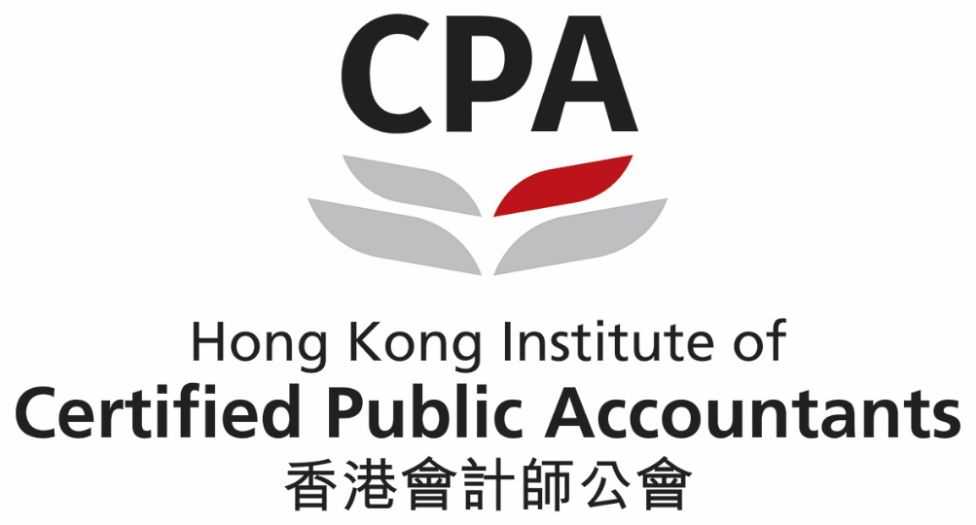
Notes:
Speaker notes:

