Slide 1
CSHK PASS Workshop 2 - Sri Lanka
Thirukumar Nadarasa – CEO, Hutchison Telecommunications Sri Lanka
Notes:
© Copyright PresentationGO.com – The free PowerPoint template library

Slide 2

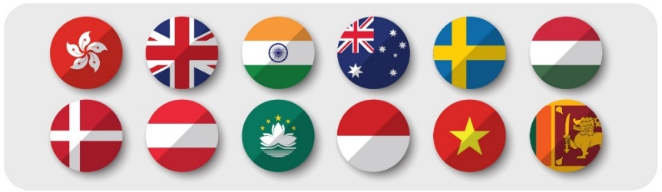
CK Hutchison Group & Hutchison in Sri Lanka
A member of CK Hutchison Holdings (CKHH)
  Over 300,000 employees across 50 countries
  Over USD 58B in revenues.
  Operates in Ports, Retail, Infrastructure, Energy, Finance, and Telecom industries.
Telecom: CKHH operates telcos across 12 markets catering to 128M subscribers globally.
Ports: Operation consists of 53 ports across 27 countries across the globe.
CKHH Telecom Footprint
Hutchison’s Sri Lanka Story
1997
2004
2012
2018
2019
2020
Entry Through Acquisition of Singtel operations
Develop new GSM Network
Develop new 3G Network
Acquisition of Etisalat Lanka Business
Network Merger & new 4G Network
Develop larger Merge Network

Slide 3
Strong Historical Bond Between Sri Lanka & Hong Kong
Sri Lanka and Hong Kong were both British colonies in the past.
Sharing a number of commonalities in:
  British based system of Government
  Sri Lankan law is based on English common Law
  A common language : English - the main language of business
  Education system is largely modelled by British missionaries
  Sharing a common religion in Buddhism
Common Past
Sri Lanka was one of the first countries to recognize the People's Republic of China in 1957
China is today the major trading and investment partner of Sri Lanka
Common Present

Slide 4
Sri Lanka: The Emerging Market Opportunity
Vibrant Growing Economy that is Relevant to China’s Belt & Road Initiative:
  Resilient Economy: South Asian economy with highest GDP per Capita (USD 3,853 in 2019) in region after Maldives¹:
    Driven primarily by export in apparel, tea, rubber, and professional services - along with the tourism sector
  Skilled Workforce: Labour productivity higher than other emerging countries in region.²
  Infrastructure Development Focus: Rapid development of transport and commercial infrastructure to underpin economic growth – primarily under the Belt & Road Initiative:
    New Port City Development Project: Special Economic Zone with preferential tax treatment, prioritized regulatory approvals, and multi-currency transactional ability.
    Ports & Highways Development: A new international airport and port developed in last decade, along with ongoing cross-country highway infrastructure development to facilitate increasing FDI & commercial activity.
As with any Emerging Market, Associated Risks Need to be Understood
  Political risk.
  Economic risk.
  Currency risk.
When basic caution is exercised, the rewards of investing in an emerging market can outweigh the risks. Despite their volatility, the most growth and the highest-returning stocks are going to be found in the fastest-growing economies.
Sources: ¹ World Bank, Data Bank, 2019; ² Internation Labour Organization, 2019;

